Slide 1
ONLINE VOTING SYSTEM
TEAM MEMBERS
G charan kumar naidu(99210042136)

Slide 2
Contents
Abstract
Introduction
Existing System
Proposed System
Features
Module Description
System Design
Source Code
Output Screenshots
Conclusion
Future Scope
References

Slide 3

Abstract
A secure and user-friendly online voting system is currently being designed.
The online voting mechanism is designed to allow voters from all around the world to choose their representatives.
Elections using electronic ballot have taken the place of recent years, the norm.
The ability to vote accurately and directly online has enabled the system to advance to the point where it can replace the current online polling system.
When registering to vote online, a user enters their Voter ID, email address, password, and thumb (because these things are all unique to them).

Slide 4

Introduction
Our project focuses on an online voting system utilising JAVA and MYSQL that allows us to shorten voting times and assures voting is secure.
For this voting system, voters can sign in using their Voter ID,and Password.
The Admin can control the entire voting system and managing over all process and taking care of the database.
The Admin can sign in using Admin ID and Password.
The admin has the access to all the details of the voters ,candidates list and details and can count the number of votes that a particular candidate have got and can declare the results.

Slide 5
Existing System
Existing system is a manual one in which users and the details of the candidates are stored in books. The users have to wait a long time in queues for voting.
Wrong and unwanted votes are given. Counting of votes are done manually which takes lots of time and inaccurate counting is done.
It is very difficult to maintain historical data. In the existing system, there is compulsory need in physical presence in the time of election polling.
In the existing system, there is compulsory need in physical presence in the time of election polling or vote counting.

Slide 6
Proposed System
The Online Voting System is a software application which avoids more manual hours that need to spend in record keeping and calculating votes.
Through this the users and the candidates are registered online.
Their information is stored in the database the admin can easily access the details of the voters and the candidates.
Every User allowed to vote only once so there is no chance of duplicated votes.
This application keeps the data in a centralized way which is available to all the users simultaneously.

Slide 7
Features
Online voting system is user friendly and secure
Reduces the time and money in conducting the offline elections
Securing counting of the results
Reduce the cost of staff and the ballot boxes
No valid vote can be eliminated from the final tally
Not possible to alter a vote
Anyone can independently verify that counting was correct
Flexibility
Mobility
Convenience

Slide 8
Module Description
The first part of the project consists of the voter page. It will have ID and Password text fields ,after entering the ID and password and by clicking login the page checks the details of the Voter or Admin and verifies with the database that is created already in My SQL .
When the details entered by the voter are correct the page moves to next page displaying the different candidates /parties names and symbols ,a button is provided for each candidate the voter can select can click only on one button and the result count is saved in the database.
The another part of the project contains Admin page where the admin can enter the ID and Password ,when the details entered by the admin are correct it moves to another page where there is voter list and candidate list and can access the database at any time.

Slide 9
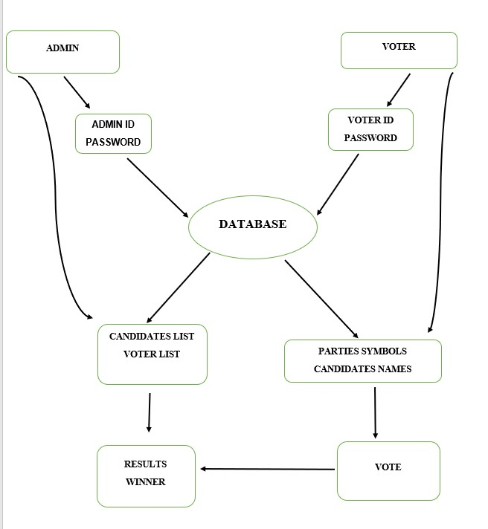
System Design

Slide 10
Source Code
import java.sql.*;
import javax.swing.JOptionPane;
public class adminlogin extends javax.swing.JFrame {
Connection con;
ResultSet rs;
PreparedStatement pst;
public adminlogin() {
initComponents();
}
public Connection getConnection(){
try{
Connection con = (Connection)DriverManager.getConnection("jdbc:mysql://localhost:3306/vote","root","kareganesh@123");
return con;
}
catch(Exception e){
}
return null;

Slide 11
private void jButton1ActionPerformed(java.awt.event.ActionEvent evt) {
String u=user.getText();
String p =pass.getText();
String query ="SELECT Username,Password from admin where Username='"+u+"' AND Password='"+p+"' ";
try{
Connection con = getConnection();
pst = con.prepareStatement(query);
rs = pst.executeQuery();
if(rs.next()){
rs.close();
pst.close();
JOptionPane.showMessageDialog(null,"Sucess Login!"+" "+u +""+p);
setVisible(false);
adminmenu info = new adminmenu();
info.setVisible(true);
info.setLocationRelativeTo(null);
}
else if (u.isEmpty() || p.isEmpty()) {
JOptionPane.showMessageDialog(null,"Please enter a username and password!");
}
}
catch(Exception e){
}

Slide 12
private void jButton2ActionPerformed(java.awt.event.ActionEvent evt) {
public static void main(String args[])
try {
for (javax.swing.UIManager.LookAndFeelInfo info : javax.swing.UIManager.getInstalledLookAndFeels()) {
if ("Nimbus".equals(info.getName())) {
javax.swing.UIManager.setLookAndFeel(info.getClassName());
break}}
} catch (ClassNotFoundException ex) {
java.util.logging.Logger.getLogger(adminlogin.class.getName()).log(java.util.logging.Level.SEVERE, null, ex);
} catch (InstantiationException ex) {
java.util.logging.Logger.getLogger(adminlogin.class.getName()).log(java.util.logging.Level.SEVERE, null, ex);
} catch (IllegalAccessException ex) {
java.util.logging.Logger.getLogger(adminlogin.class.getName()).log(java.util.logging.Level.SEVERE, null, ex);
} catch (javax.swing.UnsupportedLookAndFeelException ex) {
java.util.logging.Logger.getLogger(adminlogin.class.getName()).log(java.util.logging.Level.SEVERE, null, ex);
}
java.awt.EventQueue.invokeLater(new Runnable() {
public void run() {
new adminlogin().setVisible(true);
private javax.swing.JButton jButton1;
private javax.swing.JButton jButton2;
private javax.swing.JLabel jLabel1;
private javax.swing.JLabel jLabel2;
private javax.swing.JPasswordField pass;
private javax.swing.JTextField user;

Slide 13
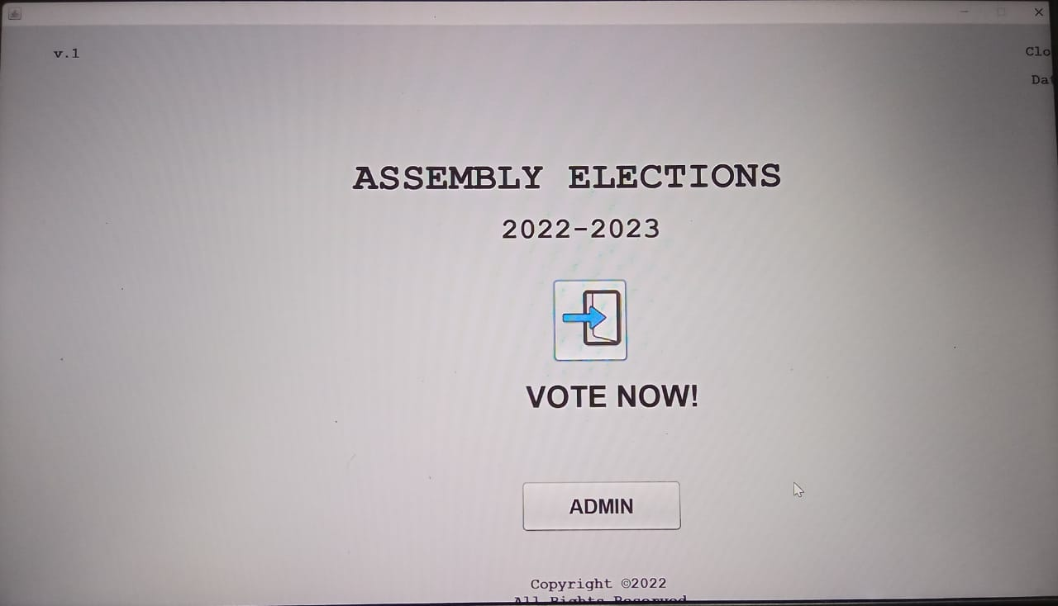
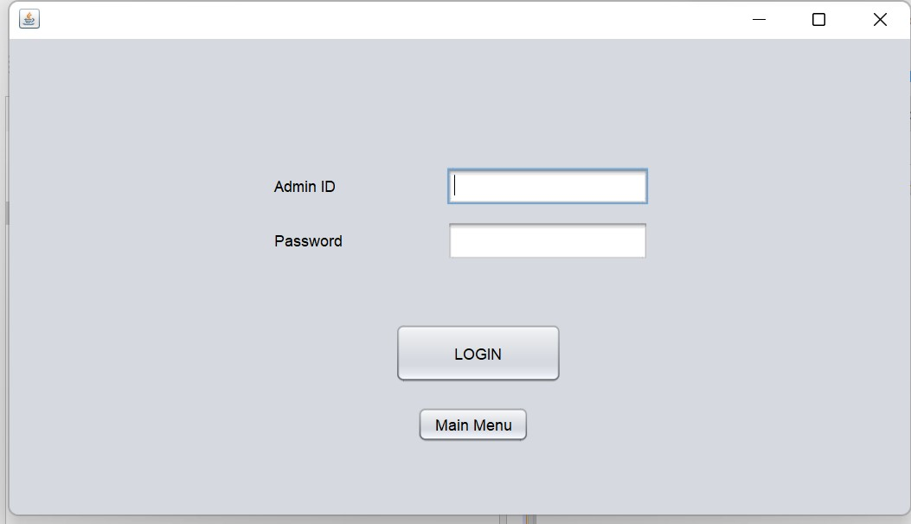
Output Screenshots
ADMIN PAGE
HOME PAGE

Slide 14
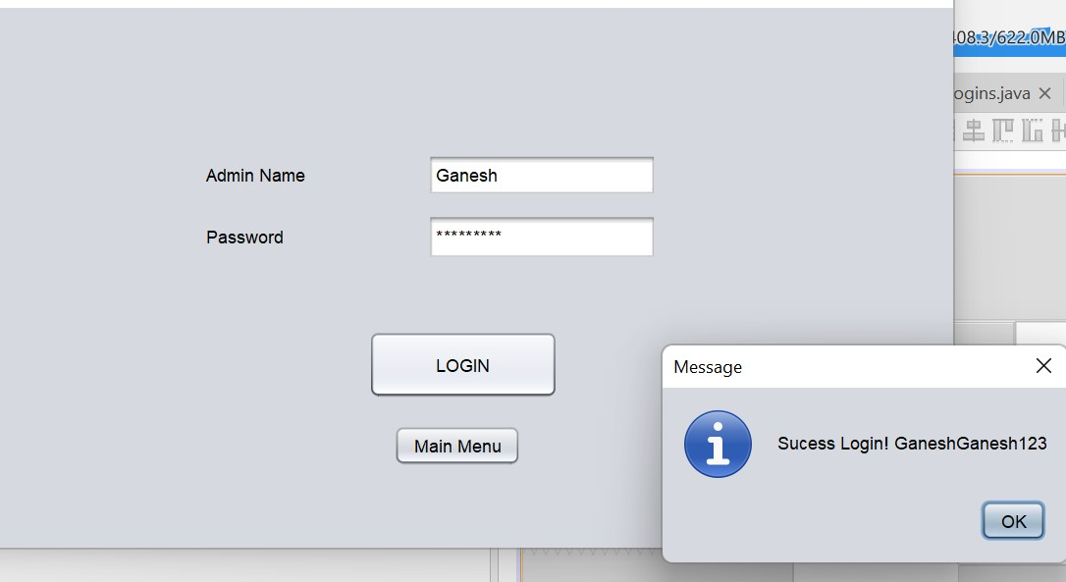
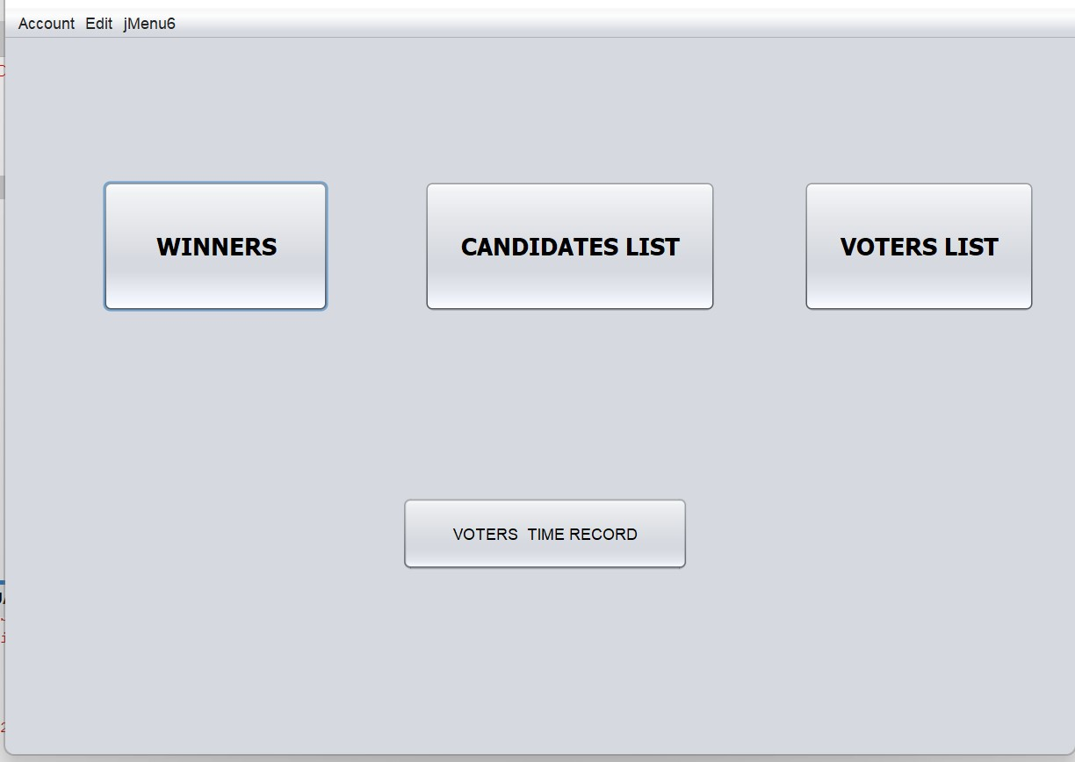
ADMIN LOGIN
ADMIN ACCESS

Slide 15
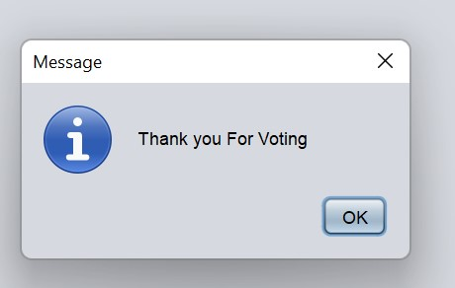
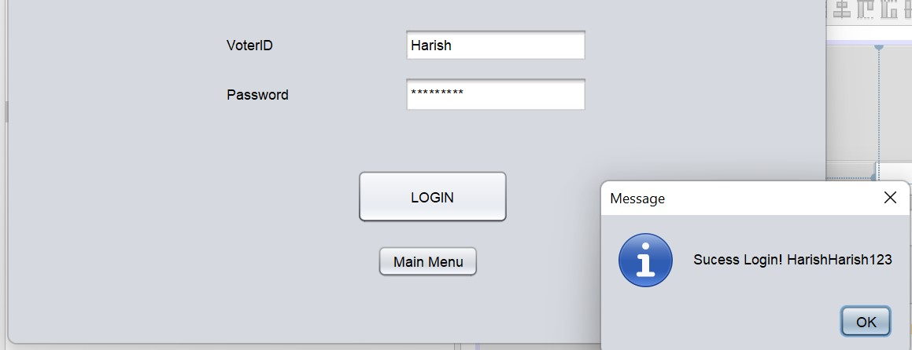
VOTER LOGIN
VOTE CONFIRMATION

Slide 16
Conclusion
Compared to traditional voting methods, online voting offers many advantages. These include lower costs, faster generation of results, easy availability, accuracy and low risk of human error. Online voting systems require a high level of security and privacy. Further development will focus on designing a system that is easy to use and provides an acceptable level of security and privacy through proper authentication.

Slide 17
Future Scope
Our project may help the election commission to conduct elections in online mode there by reducing the cost of maintenance and declaring results in easy way .This also helps to reduce fake votes and one voter can have only one vote .All the credentials of the voter are verified and given access this reduces time of verifying the credentials of voters. It also reduce the wastage of the papers in ballot voting system.

Slide 18
References
Al-Ameen, A. and Talab, S. A. (2013). The technical feasibility and security of e-voting. Int. Arab J. Inf. Technol., 10(4):397–404.
[2] Hussien, H. and Aboelnaga, H. (2013). Design of a secured e-voting system. In 2013 International Conference on Computer Applications Technology (ICCAT), pages 1–5. IEEE
[3] Kohno, T., Stubblefield, A., Rubin, A. D., and Wallach, D. S. (2004). Analysis of an electronic voting system. In IEEE Symposium on Security and Privacy, 2004. Proceedings. 2004, pages 27–40. IEEE.
https://www.youtube.com/watch?v=wgAjRQInzVI
https://github.com/topics/voting-system?l=java&o=desc&s=
https://www.researchgate.net/publication/358907608_Online_Voting_System_Using_Java_and_SQL

Slide 19


